Slide 1
AI and the Writing Process in Multilingual Classrooms
Dr. Christina Kitson
University of Central Missouri

Slide 2
Multilingual Writing is a process
Working with your organization/institution you can establish your classroom rules about AI
Pre-writing skills- the alphabet, words, tenses, sentence construction, mechanics and grammar
Early writing- sentences, paragraphs, topic sentences, thesis statements
Essay writing- idea generation, brainstorming, integrating thesis and topic sentences, drafting, revising, editing, finalizing
Academic writing- citation, style, formatting, references
Think about the steps you are teaching and what your students already know (can they ask others for help?)
AI can help with “academic voice” and specific styles for ELs

Slide 3
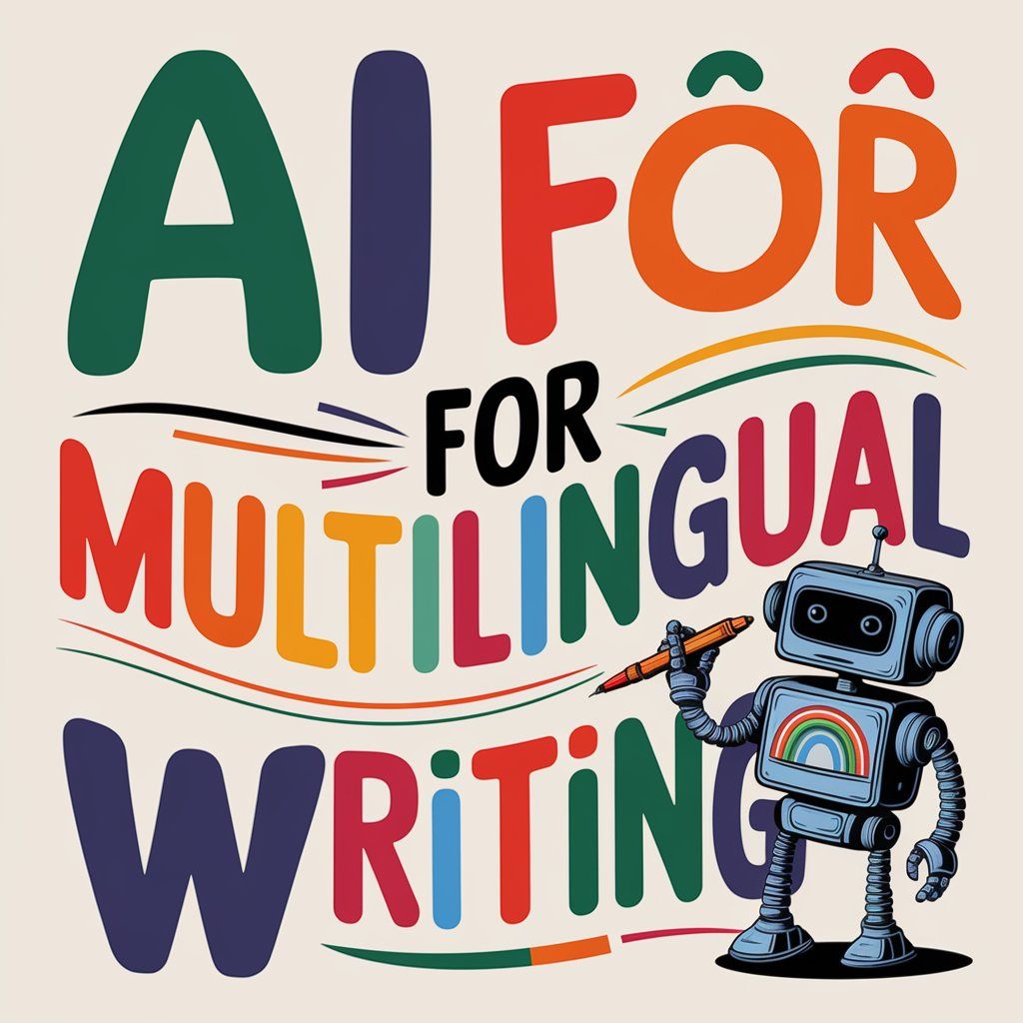
Ideas for AI Use
Ask AI to provide content with mistakes for students to correct
Ask AI to help write grammar and sentence construction tasks
Ask AI to create passages for response
Ask AI to create images to go along with readings
Ask AI to create songs to go with a topic
Ask AI to tutor on grammar and mechanics
Ask AI to provide basic feedback on writing
Ask AI to review your feedback and look for trends
Ask AI to write an AI proof prompt

Slide 4

Integrating AI in Your Class
Rework pre-AI prompts to make sure you have AI resistant ideas/tasks
How can you integrate AI into your classroom-
“Trojan Horse” Dracula and Cats
Have students compare and analyze AIs answer to their answer
Allow translation or cultural look ups
VoiceWave extensions that allow voice recognition for struggling typers
Provide a guide to students on when AI is acceptable (and what it might look like at each stage)
Ask AI how it can help you in your class

Slide 5
When to use AI?
No AI allowed (no use of any AI tool for any part of the assignment).
AI can be used for anything in the assignment but prompts and draft histories need to be submitted.
AI can be used for anything in the assignment.
AI can be minimally used (idea generation, simple editing, only approved platforms allowed).
AI can be used for specified activities (included in the assignment description) or a specific AI can be used for certain tasks.
AI can be more generally used, but the student needs to detail exactly how it was used and include prompts in their submission.
AI can be used for idea generation, organizing, outlining, drafting (main writing still done by the student), and editing, and when submitted all prompts and a revision history must be provided.
A graphic with your expectations should be posted
Could be included in the assignment itself
Modify to fit your needs
Image inspired by the AI Assessment Scale; Perkins, Furze, et al., 2024

Slide 6
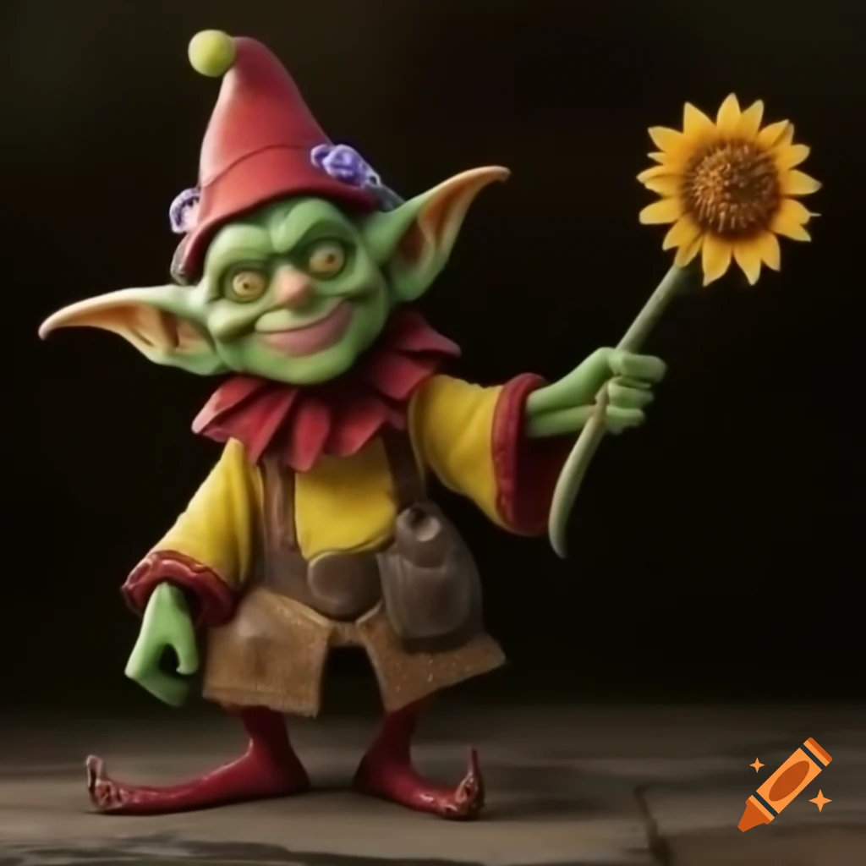

AI for Multilingual Writing
Idea Generation:
Claude, ChatGPT, Gemini, and CoPilot
Grammar and style suggestions:
Grammarly, Hemingway Editor, Slickwrite, Wordvice, and chatbots
Research Assistance:
Scispace, Scite.ai, Elicit.org, Research Rabbit, Genei.io, semanticsscholar.org, and consensus
Content organization and structuring:
Copy.ai for outlining, Mindmeister for mind mapping, Goblin tools and Quillbot for paraphrasing
Language Translation:
Google Translate and DeepL
Academic Writing help:
Conch AI, Curie, and Scholarcy
Creative Writing Help:
Sudowrite

Slide 7
Addressing Misuse of AI / Academic honesty
Designing lessons that blend in-class instruction with out-of-class review and revision encourages students to engage deeply with course materials and fosters independent learning skills.
Have a robust Academic Honesty policy that students are taught.
Have clear policies on acceptable AI use.
Have clear policies on punishments for unacceptable use.
Engage students in discussions about plagiarism, citation practices, and the ethical use of AI tools.
Redefine plagiarism

Slide 8

Identifying AI Use
Perfect grammar and mechanics- everyone makes errors
Unusual or obscure word choices (though could be thesaurus)
Work that is very inconsistent with class writing or previous work
No personal opinions, reflections, anecdotes
Repetition of language, ideas, patterns (delve)
A summary or report style
Some sections are great, others have issues (combined AI and person)
Real writing has inconsistencies, shifts in mood, and emotions
AI writing is often more basic, blunt, neutral, and emotionless
Ask about writing content, sources, try to see what they know
AI Detectors do not work!

Slide 9
What can you do?
Research- check into different platforms and ideas
Begin small- bring in a specific tool at a specific time
Be open- it might not work the way you want
Be reflective- make sure you take notes and reflect on each experience with bring AI into the classroom
Talk with others- bring up AI integration and get a group to work together to create lessons
Consider publishing- we are all learning about how this works, share your results!

Slide 10

Thank you!
Questions?
Contact: Kitson@ucmo.edu

